Slide 1
Popeye Chess Engine
Tudor cheregi & Victor Macinic

Slide 2
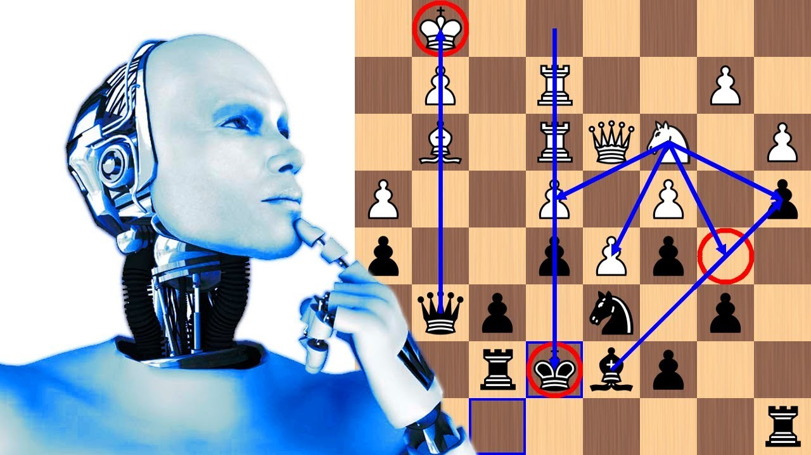
Description of the problem
One of the goals of early computer scientists was to create a chess-playing machine. In 1997, Deep Blue became the first computer to beat the reigning World Champion in a match when it defeated Garry Kasparov. Though not flawless, today’s chess engines are significantly stronger than even the best human players, and have deeply influenced the development of chess theory. In comparison with Deep Blue’s strategy which was comprised of several heuristic methods and a minimax tree search based algorithm, our approach is a little bit closer to what modern engines (Stockfish NNUE, Alpha-Zero) make us of: neural networks.

Slide 3
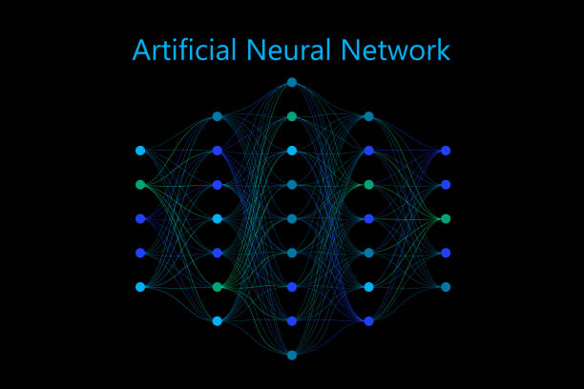
Our approach
In comparison with very complex and general models that are capable of adapting to various environments (games), our approach is to create a neural network that is not capable of playing chess by itself, but rather is very good at evaluating random chess positions. Since there exist known metrics for evaluating a given position/configuration of pieces we can create our model on a fully supervised manner.

Slide 4

Data
In order to train an ANN in a fully supervised manner we first need to gather some data which will represent the knowledge that our model should be able to learn.
Firstly, we selected a large dataset of chess games from numerous grandmasters. Each game is comprised of a particular sequence of moves(positions) that we labeled using one of the strongest chess engines at the moment (Stockfish). Every position is afterwards turned into a FEN string representation and saved to our train data file.

Slide 5

preprocessing
Our experiments have been conducted using three main tensor input representations.
1.Algebric representation - An 8x8 matrix, each square having it’s piece value (scaled to [-1,1] ) or 0 if there is no piece on the square.
2. Sparse representation – An 6x8x8 tensor representing an 8x8 matrix for every piece (Rook, Knight, Bishop, Queen, King, Pawn), each square having a value of -1 (if there is a black piece on the square), 0 (if there is no piece on the square) or 1(if there is a white piece on the square).
3.Bitmap representation - An 12x8x8 tensor representing an 8x8 matrix for every piece (Rook, Knight, Bishop, Queen, King, Pawn) of each color (Black or White), each square having a value of 0 (if there is no piece on the square) or 1(if there is a piece of the corresponding color on the square).

Slide 6
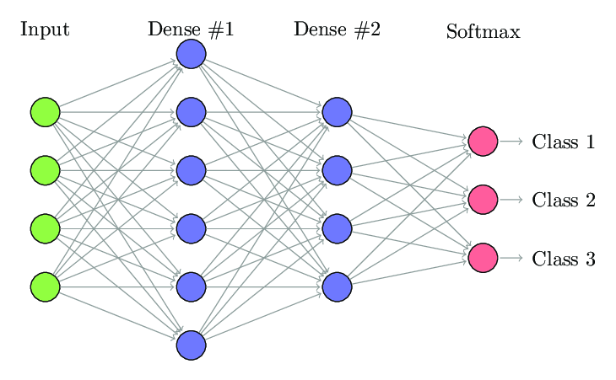
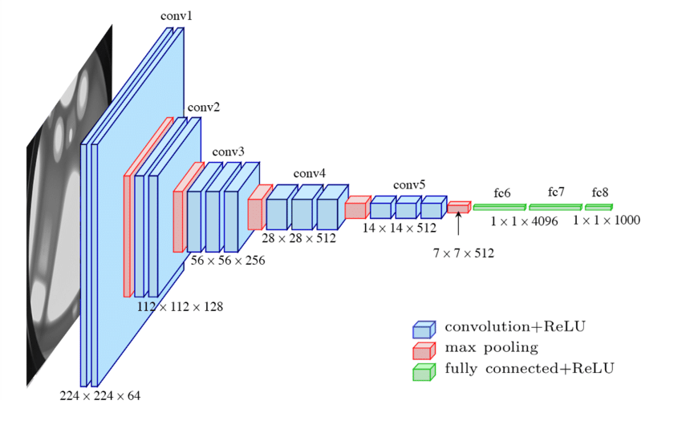
models
Our experiments have been conducted using 2 main architectures:
Model 1 A network with fully connected layers.
Model 2 An FCN (fully convolutional network) to which have been added some fully connected layers in order to provide additional computation in hope of achieving better performance.

Slide 7
Regression vs classification
Regression: We first tried to mimic Stockfish’s behaviour in terms of evaluating a position, therefore our models are supposed to predict a real value representing the exact evaluation of the current position.
Classification: Due to the complexity of the regression problem we tried to simplify the task and express the regression problem as a multi-label classification one. Thus, the evaluation of the position (the label) was converted into 3 classes based on which color is supposed to have a better position (0 – black is better, 1 - equal position, 2 - white is better).

Slide 8
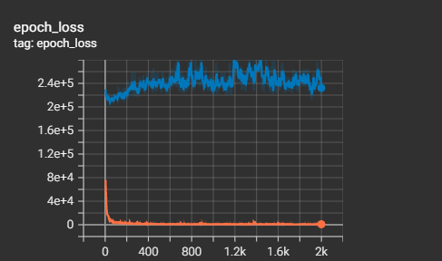
Results
For the time being our best result was obtained by the convolutional model and it’s results can be observed in the picture below.
We know that for the time being the model struggles with the overfitting problem but our hint is that the dataset we used was too small to enable any kind of generalisation (~30k positions) so the first step for further experiments would be to use a larger dataset (~5.000.000.000 positions).

